Slide 1
Final Go thru for this week
-> Portal navigate and create as per UC1 & UC2
-> terraform: hands-on as per UC1
VNet, subnet, firewall, app gateway, WAF (Web app Fw)
VM Build thru terraform & Portal
Go thru more features of VM incl disks, monitoring, logs, dashboard, healthchesks
-> DevOps navigated, must revise YAML file and CI/CD as per UC3
Repos, Pipelines, Tests & Artifacts
Create and test repo in git and push/pull to azure portal
Create pipeline / yaml and run the code to deploy IaC
End result - Create VM using Terraform with Pipelines [Code in pipeline]
->Portal Navigation
Create db & access from SSMS
Create and manage db under single server(s)
-> Hands on Linux with commands practice and hardening with commands
-> Hands on Windows 2026 Server with Domain creation and server admin
->

Slide 2
Azure Cloud Portal
Compute [VM, VMSS, Images, ssh keys, Wind & Linux VMs ]
Networking [Vnet, subnet, AGW, FW, Bastions, Pub IP/Priv IP, vpc peering, LB]
Storage [Storage Accts, Disks,
IAM / Security - Azure Entra ID, Users, Grps, Subscrs, Mgmt Grps, Tenant
DevOps Org
Database - [Azure Database, SQL Server with Windows OS, MySql, Postgres SQL,
Access Azure db from Client using SSMS (Sql Server Mgmt Studio]
Create DB, Manage DB, Backup DB< etc,.
Create Tables, Views, Seq, and SQL Queries [Select, delete, update] = Create, Delete, Drtop, truncate
DB hands on in VM with SSMS and other db tools,
Access db and do above hands on practices of sql

Slide 3
Date : Week 1 of March
Category | Resources
Compute | VMs - Windows & Linux Images, Instance types, Bastions | Create 2 Win VMs & 2 Lin VMs
Storage: SG & Disks | Storage acct: Purpose & types of storage accounts, Create & Attach disks, types of Storage volumes, (eg. HDD, SDD.)
Networking: Private Links, DNS - Adv | VNet Subnet ALB NLB, NSG, Route Tables NAT GW, NIC, VNet Peering | Create 3 Vnets, each 3 Subnets
Database | Azure SQL Database SQL Server on Azure VM | Create 2 databases with 1 server [ASD] Access thru SSMS
Azure DevOps | DevOps Org -> Project-> ADO Repos, - Azure Repos & Git Repos Pipelines - Yaml Artifacts

Slide 4
Security | Firewall ASG WAF
App Services | Create webapp & Webapp+DB
Function App | Create Function App
Subscriptions | Tenants, Mgmt Grps Subscrs

Slide 5
Week-01 of March 5th & 6th Slides
Category | Sub Category | Status | update
 | Az App & Func service | Completed | 12/Feb
 | AKS & Container | Intro & Create sample services. - 30 min | 13/Feb
 | Az Firewall |  | 12/Feb
 | Cost Mgmt & Billing | 30 min / recap | 13/Feb
 | Bastion | Completed | Hands-on Done
All Known Services | All Review with Varsha | To do - 30 min /Night | 13th Feb 1 Session

Slide 6
Category | Services | Status Update
Compute & General | VM, VMSS, Images, Types of VMs [B1,A1 etc.,], Regions, AZs, Subscr types, Mgmt Grps, Bastion | E0 - At present E1 - Target by End of Feb’26
Networking & Security 12-Feb | VNet, Subnet, App GW, NSG, LB, ExpressRoute, Peering, & Firewall VNet peering VNet1 - LBRCE F1 - 1st yr 10.1.0.0/15 VNet2 - LBRCE F2 - 2ndyr 10.2.0.0/15 | E0 - Vnet & Subnet Others to Complete
Database | a)Azure SQL Database b)SQL Server on VM c)MySQL - Basics | E0 - At Present No further required.
DevOps [Recap, for CI/CD, Pipeline Build, Git Connect repo & Yaml file] | CI/CD, Devops Org, Git, Yaml file | E0 - InProgress
IAM | Azure Entra ID | E0 - Yet to Start

Slide 7
Pending Area | Status | Update/ FInal date
Resume | InProgress | 14/Feb
Linkedin Update |  | 14/Feb
Mock Interview Prep |  | 16/Feb
References Follow Up |  | 20/Feb Onwards

Slide 8
Doubts or Clarifications Needed:
Compute > how, what, when.. -> VM, VMSS, image, automation
Storage -> Stg acct, BLOB, Az Fles,
Networking & Security -> Vnet, Subet, App GW, IGW, NSG, Firewall,
Database -> Az SQL DB, SQL Srv with Windows OS.. Use SSMS tool to access DB
DevOps -> Dashboards, Repos, Pipelines, Artifacts [Repo -> Az Repo, Git Repo etc.,]
IaC -> Terraform ? How, when , why
Tools > Bastion, WAC (Wind Admin Center), Terraform, SSMS,
Services Common: App / web Services, Func App services, Container Apps, Kubernetes serv.
General => Cost Mgmt, Subscr Models, Mgmt Grps, Tenants, Billing
FinOps -> Cost Optimization, Resource optimization or utilization / availability etc., identifying zombie/orphan resources,
Varsha comments:

Slide 9
Technology Stack: Prep for Varsha
OS - Windows Servers administration [Domain Controller, DNS, managingUsers & Groups etc.,] & Linux [CentOS, Ubuntu, RHEL] - Build / spinup/ create virtual machine with Windows Server & Linux (Ubuntu) in Amazon Cloud
Cloud Platforms - Azure [Microsoft]. AWS [Amazon]
Tools - Terraformn [IaC], GitHub / Git
Technology - Databases & Networking

Slide 10
Azure Portal - Review
Categories:
Compute - OS(Windows & Linux) IaaS with IaC Terraform
DevOps - Basic devops
Network - Basic networking VNet, Subnet, AppGateway etc.,
Operations -> Monitoring, Storage, IAM, Security
Week -1

Slide 11
Day 01 Notes:
Platform / Operations Systems - Microsoft Windows and Linux [Ubuntu, RedHat, Suse, Debian etc.,]
Physical Hardware PCs- Laptops, desktop,
Virtual PCs / Virtual Machines - To create VMs in Public Cloud environments like Azure & AWS Portal
WIndows Types - Desktop OS’s & Servers OS
Windows 10, 11 - Desktop OS for personal Laptops or Desktops
Windows 2019, 2022, - Server OS for Servers in the Organizations
Linux Servers are for deploying Applications, Databases etc., and also used for various Server Operations.
-Log into AWS Portal
-Go to Dashboard & Select Compute category
-Press ‘Lanuch Instance’ and select Windows OS Image
-Select Keypair - RSA for Windows
-Ensure instance type t1.micro / t2.micro etc.,
-Ensure VPC & Subnet and Public IP created
-Click on Launch Instance to create virtual machine

Slide 12
Day 02 Notes:
Category | Service | Azure Cloud | AWS Cloud
Compute | VM | VM | EC2 (ecc)
Storage |  | Storage Acct | S3

Slide 13
Day - 03
Download Putty.exe & Connect Ubuntu linux vm.. Login with userlinux @ password - Vijayawadad@12
AWS CLI - Install & Configure - Installed
Azure CLI - Commands Practice - Installed
Azure VMScaleSet - Create VMSS & verify
Azure Vnet -> public IP, Private IP, explanation
Azure Database - Create SQL Database & Connect
Install SSMS in Windows VM
Azure DevOps - Create Org, Project, and overview navigation of DevOps Organization

Slide 14
Compute | VM | App service | Ssh Keys | Images
Networking | VNET | Subnet | Firewall | Bastion | pubip/route table, gateways
Storage
Database
Security
DevOps

Slide 15
In azure Portal
Create -> RG - Done.
Create -> Vnet, Subnet, Security Grp
Creat e-> Storage Account
https://www.youtube.com/watch?v=hGaEMiQopOQ
DB
User
Server
DB

Slide 16
Day 06 - 2/Jan
Azure DB:
Create new DB Instance and DB server and connect thru SSMS
Create new SQL VM with Windows OS Server
This scenario, SQL DB Installed on Windows 2022 Servers
No need to install SQL Server separately..
Azure Devops:
Go to Azure Devops Portal [Devops Organizations]
Create New Org
Create New Proj & type of Proj
Consists of ADO boards, Repos, Pipelines, & Artifacts.
At Boards level knowing
New tasks, assign, resolve
At Repos level
Create new repo, export repo, Git

Slide 17
Day 07 - 6/Jan
MS SQL Server 2019 on Windows 2022 Server ->
In this VM, SQL Server already installed (pre-installed) with Enterprise / Std Edition
Open SSMS & Connect to DB using OS credentials.
Create DB, Manage DB
Create Tables etc.,
Create Users, Manage Users. Etc.,
SQL Query Window & using commands, can create DB Schemas [Tables, views, sequence, synonym etc.,).
DDL - Data Definition lang - Create, Alter, Drop
DMS - Data Manipulation Lang - Select, Insert, update, Delete
DCL - Data Control Lang - Commit & Roll back.
SQL - Stru Query Lang [Its a common lang for all RDBMS]
RDBMS ? - SQL Server, Mysql, Postgresql, Oracle, Sybase, DB2, [SQL]

Slide 18
Azure Portal -> Username & Pwd for microsoft account - Done
Create a subscription with valid debit card or credit card -> done
New Subscription is created ->
To create any resources need RG -> Done.
Then, create resources like Vm, storage, netowrking etc.,

Slide 19
Category | Service | Services
Compute & General | VM, VMScaleSet | Function App & App Services
Database | Azure DB, SQL on VM | AKS (Kubernetes) & Containers
Networking & Secu | VNet, Subnet, Firewall | Bastion - NW
Storage | Disks, Storage Accts | NSG - Network Secu Grp - NW
Category | Service | Category | Service
Azure DevOps | DevOps Org
IAM - Identity & Access Management | Entra ID

Slide 20
Links for Videos:
Week -1

Slide 21
Tasks to be performed:
-Create 1 Vnet 2 subnets and attach new vnet to new VM
Week -1

Slide 22
Azure - Cloud [Server Build, Foundation & Automation]
-IaaS
Compute - VMs,
Storage - Storage Accounts, Disk Types,
Network - Vnet, subnet, Gateway,
Database - Basics..
Security - IAM
IaC - Automation - terraform
Monitoring -
Week -1

Slide 23
IaC - Terraform [Validation state]
Tools Needed: Download Terraform.exe from Hachicorp
Open Command prompt & create <terraform> folder using file explorer or command prompt using C:\mkdir terraform.. Copy terraform.exe into terraform folder.
Install Azure CLI from Site. - Install msi package
Az Login -> Login with Azure subscription & Connect
> terraform init & verify upgrade…
Create .tf scripts to build the azure resources

Slide 24
Create any Linux VM [Suse, Redhat, CentOS, ] or use WSL in VM
Linux VM Hardening by
Network Setup, Tools Setup(terraform, az cli, ansible etc.,)
Basic Commands & Advance Commands
Run Terraform scripts

Slide 25
IaC - Infra as Code
Terraform using script
PowerShell Scripts / Commands
Ansible Script - Pause
CLI - To build the env.
Az CLI
Pre-Req:
To connect / configure TF, first connect AZure (CLI must be installed.)
Install AZ CLI (Wind or Linux)
AZ login & validate the login
Download terraform.exe
Terraform init

Slide 26
Terraform - Starting session .
C:\TF\terraform.exe
.tf ,file extn
main.tf is only one file with all the azure resources to build
Optional .tf files -> variables.tf & providers.tf
Env Build - Dev, PRD, QA -> Each env needs their own main.tf & others. In a diff folder stru.
Terraform init
Terraform validate
Terraform apply
Key Resources / services to build in terraform are
Networking b) Compute / VMs c) Storage d) Security (App GW, Firewalls etc.,)

Slide 27
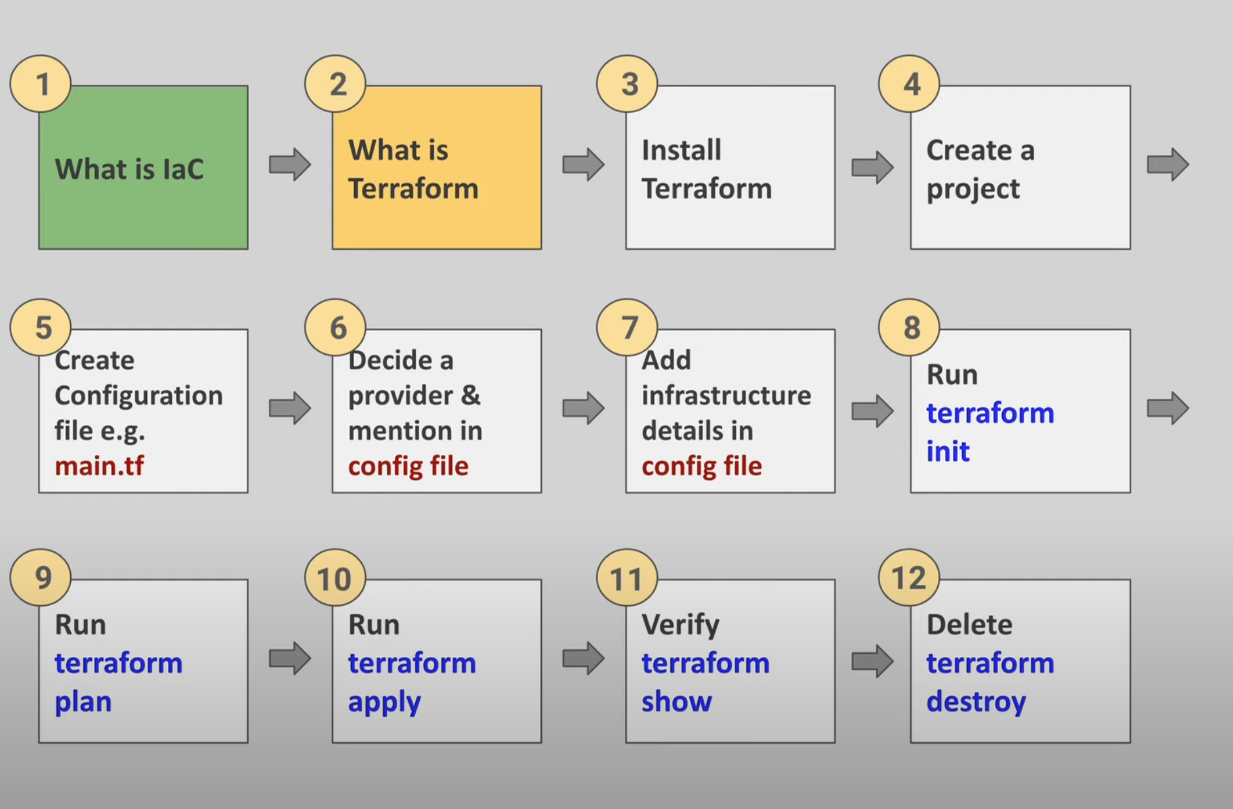

Slide 28
SuSe Linux - Hardening Tips
Install Packages using

Slide 29
CentOS Linux - Hardening Tips

Slide 30
Linux - Operating Systems
SuSe -> YaST(yet another setup tool) #yast –qt, --gtk, -l etc.,
After normal user -> $sudo -i to # prompt for admin commands
#yast for GUI admin of SuSe
#pip, zypper tool to install packages / services
#zypper install tftp / etc., #zypper update
#rpm -qa | grep <package name> to find in the installation list.
Ubuntu ->
Cent OS ->
RedHat ->

Slide 31
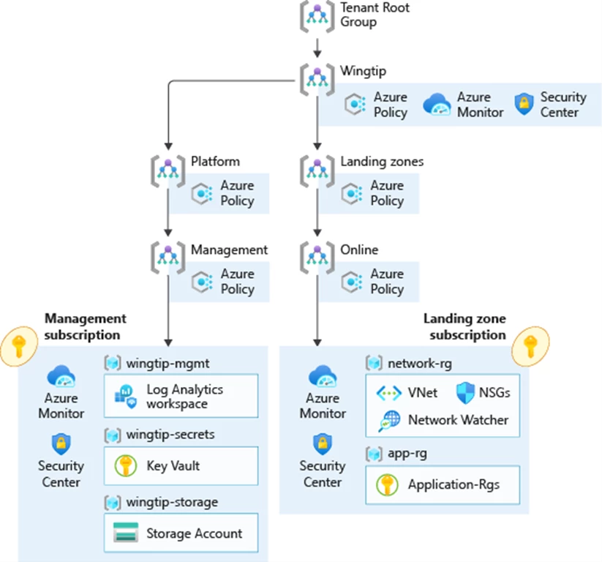

Slide 32
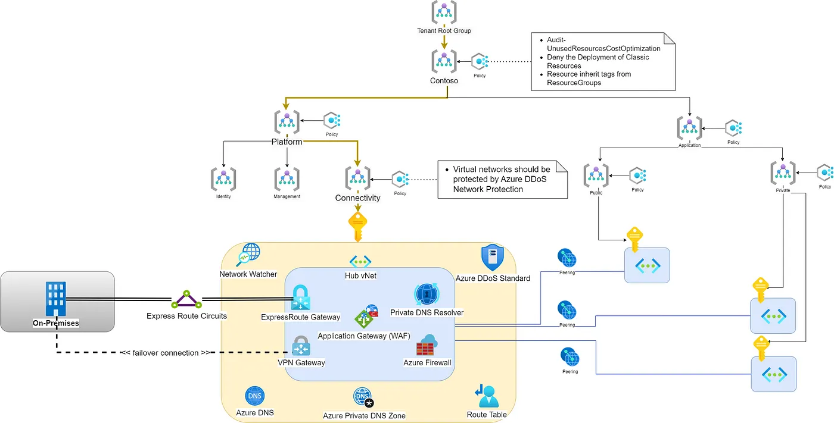

Slide 33
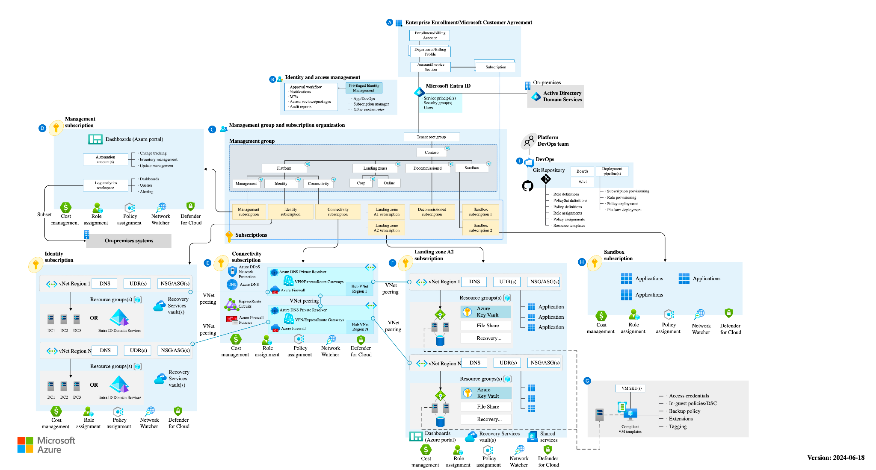

Slide 34
a)Terraform - Complete review
b) Portal
AAD / Entra ID - Subscription-> IAM, Users, Groups, Roles & Prev
Create & manager users Under Entra ID AAD.
Complete DB admin - L1 Tasks
Visual Studio Code- Terraform exec using terminal on multiple environments -
Reveiw DevOps - Org

Slide 35
Imp Links:
https://github.com/alfonsof/terraform-azure-examples/tree/master/code/05-cluster-webserver
https://github.com/Azure-Terraform/terraform-azurerm-virtual-machine/blob/main/main.tf
https://github.com/jakewalsh90/Terraform-Azure/tree/main/Azure-Firewall-DemoLab
https://github.com/andreipintica/Azure-Terraform-Scripts/blob/master/main.tf

Slide 36
Tasks
Create new RG, New Vnet, New Subnet (20.0.2.0), VM - Win 11 Pro with Pub IP, Host Name:
In VMIndia VM - Download & Install Terraform, AZ Cli,Visual Studio (with TF, AzCli and other Extn) - Downloaded files available in Download folder.
Install and config terraform with main.tf file in >Documents folder.
Create sql database from Portal and attach the database in SSMS. Create few tables, insert records to table. Create some queries from Query window.
Visual studio code.. Practfice diff diff terminals

Slide 37
Tasks
Create new storage account and practice all features. Use google for steps and other misc configuration.
Create firewall and set firewall rules with new Vnet, subnet etc.; assign the firewall to block the youtube.com or any other sites and map the Firewall to a new Virtual Machine in the new region. - Use google to research and do the hands-on.
Create disks (standard) multiple sizes (10gb 20gb) and allocate the disks to windows VM. Understand various types of disks (ssd, hdd etc.,) - Understand IOPS, latency etc., from google search

Slide 38
Ubuntu - Hardening / Installing tools
https://www.digitalocean.com/community/tutorials/how-to-install-and-configure-ansible-on-ubuntu-20-04
#apt install python3-pip
#sudo apt-add-repository ppa:ansible/ansible
#sudo apt update
#sudo apt install ansible

Slide 39
GIt Notes
Make sure install git on linux VM
Token for spfbang Git User:
$git remote add origin

Slide 40
Git Notes:
$ Git init | It will create .git folder in the current folder
$ Git status [red color]
$ Git add . & check status to become green color
$ Git commit -m “First Commit”
$ Git branch -M main to create main branch
$ Git branch - Switch to main branch
$ Git config —global user.name “jayasimhagit”
$ Git config —global user.email “jayasimha.xyz@gmail.com”
Personal access token -> Git Settings -> Developer settings. -> Personal Token
$ Git token -> update..
$ Git push -u origin main and see the files uploaded in the git repo
$ Git status and see uncommitted code..
$ Git commit -m “2nd commit with new stuff” file name <main.tf>
$ Git push -u origin main

Slide 41
Git Notes
-To login to linux from command prompt - ssh userlinux@20.151.57.219(ssh username@ip)
- to know working directory - pwd
-to create a folder / directory - mkdir name
-to list of files in directory - ls
- to create files -> touch main.tf / vi var.tf
- to know version of git -> git - - version
- login to git and create a new repository and we can see the basic commands using command prompt
- echo "# spfgoa" >> README.md
- ls -ltr -> this command gives the access related, user name, file name and other details as below
-rw-rw-r-- 1 userlinux userlinux 0 Aug 17 09:41 main.tf
- git init
- git add README.md
-to know the status of files details -> git status
- to rename the branch name - git branch -M main
- for the first time got to github - right top corner - settings - developer settings -personalised accesstokens - tokens(classic) - generate new token (new token ) - copy it somewhere

Slide 42
Client OS (Laptop / Desktop / VM at Portal or VM at Lapop in VMware WS) / o | Server OS (Physical Computer / Laptop / VM at Laptop in Vmware WS, Azure Portal or any other Cloud Portal) r VM in Hyper-V in Server OS
Windows 10 | Windows 2008
Windows 11 / 11 Pro | Windows 2012
Windows 7 | Windows 2016 / 2019
 | Windows 2022

Slide 43
Server Build & Hardening for Windows Server OS 2022
Server Manager
DNS & DHCP
AD DC
Build Domain Controller
Hostname = INBLRDC01
Domain CONTROLLER Name = SPFTEK.COM
Create 2 to 3 users, change permissions to normal user & domain admin, login with other users in domain (eg. Siddhi Pranamya as Domain admin & Srikar Buddhiraju as Domain user.)
Various server OS - 2019, 2022,
Various server editions - Standard, Enterprise, Data Center
WAC / WAS - Windows Admin Console or Center.
Build VM - WinPro 11 with Same RG, Vnet, SUbnet (eg. 10.0.x.x)
[Task is build Server VM from Portal and make that server as a domain controller as per above details, Create another winpro11.. And add this client VM to DC]

Slide 44
Azure DevOps - CI/CD
Repos
Pipelines
Boards & Artifacts

Slide 45
Azure Cost Management - > Fin Ops
Subscription -> Cost Management, Billing etc.,
Cost M anagement + Billing
Free services - Complete understanding of Free Services from Azure
Quotas
Reservations [1Yr, 3Yr, RI, Spot Instances] - Click-Here For Reservations Notes
Important:
Billing period, INR, Offer, Status on the Subscription
Current and Forecast
Cost Management -> Cost Analysis, Alerts, Budgets, Advisor Recomm with Right sizing, RI
Cost Analysis using RG, Geo, per Resource etc.,
Create Budget Alert & Create Rule with Budget Alert…
Azure Advisor recommendation for FinOps wrt Utilization of Resoruces

Slide 46
VM Types, Pricing & Models.
https://spot.io/resources/azure-pricing/azure-vm-pricing-vm-types-pricing-models-and-examples/
Cost Optimization & VM Comparison - IaaS
https://www.thomasmaurer.ch/2020/01/how-to-reduce-the-costs-of-your-azure-iaas-vms/

Slide 47
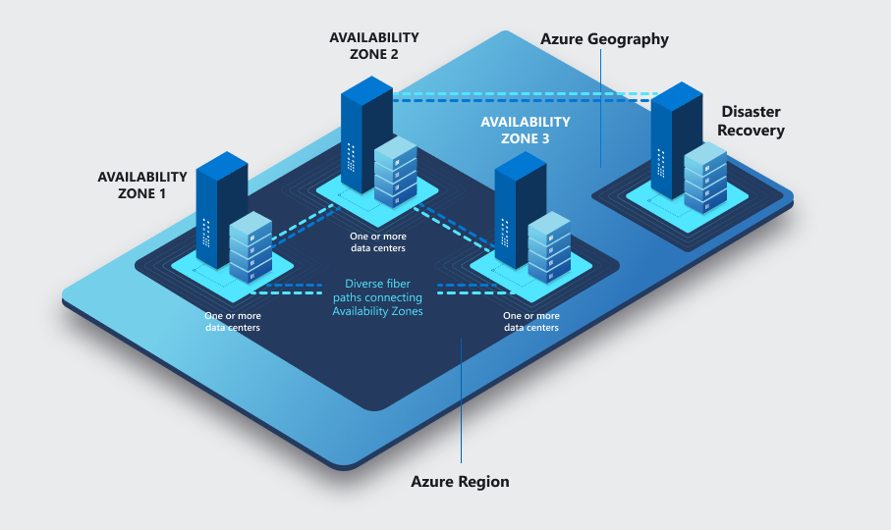
Azure - Regions, AZs and DCs
https://learn.microsoft.com/en-us/azure/reliability/availability-zones-overview?tabs=azure-cli

Slide 48
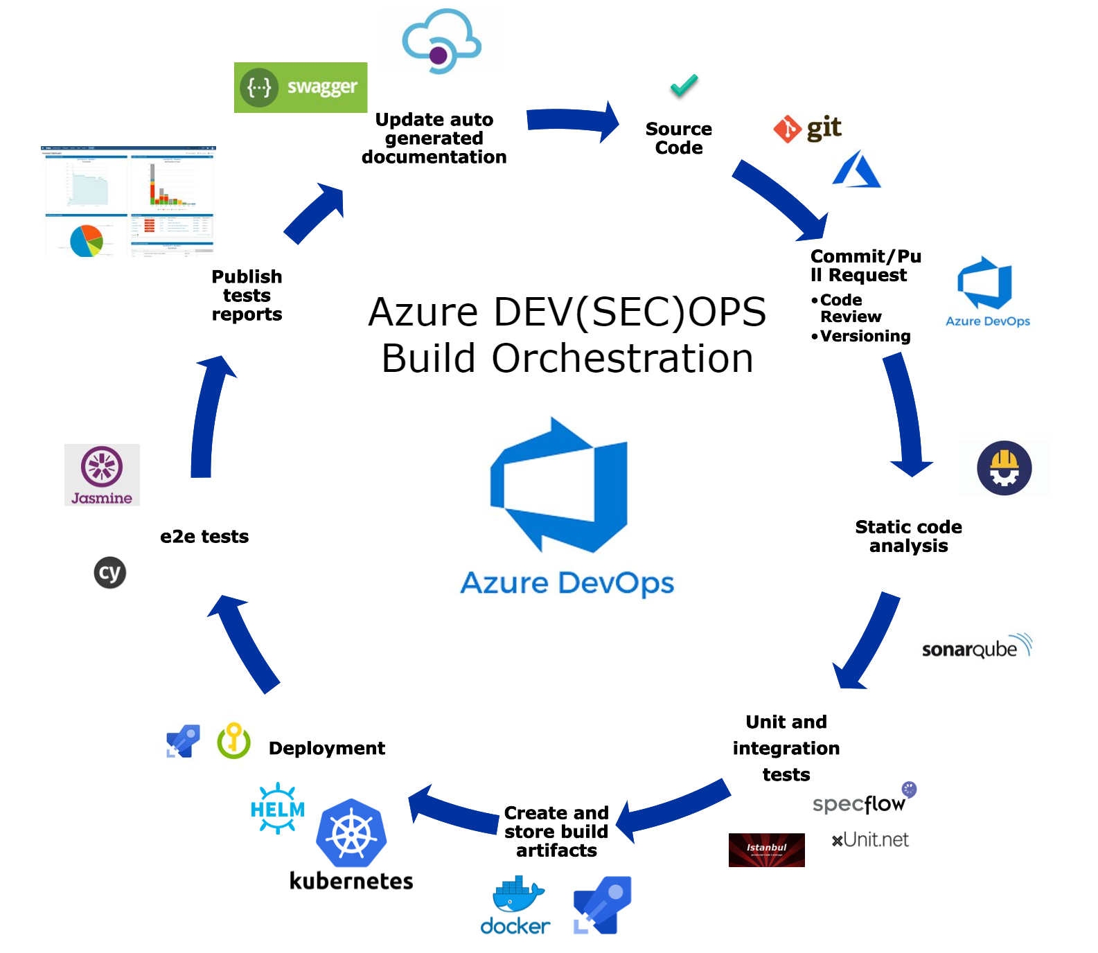

Slide 49
Service | Video Link - Primary | Secondary
DevOps - Repos & Pipelines-1 | https://www.youtube.com/watch?v=_Qq3HO5l3ko | https://www.youtube.com/watch?v=Idc6dk_dVbU
Devops - Repos & Pipelines - 2 |  | https://www.01mrN4youtube.com/watch?v=4DrOA
Az - Storage - 3 | https://www.youtube.com/watch?v=x_7X4Vs1V8w
Az - Networking & FW - 4 | https://www.youtube.com/watch?v=_sDbdl2yxx8 | Firewall Services
Az - Entra/active directory - 10 |  | https://www.youtube.com/watch?v=MTzURXtXQWY
Az - IAM / AAD - 9 | https://www.youtube.com/watch?v=Rz5_oJD0Jso
Az - Cost Management - 11 | https://www.youtube.com/watch?v=6S9UdBupFsA | https://www.youtube.com/watch?v=IojgArLK8zM
Az - AppService - 5 | https://www.youtube.com/watch?v=MNN9M11FODI | https://www.youtube.com/watch?v=x6JXqDKRjos
Az - Functions = 6
Git/Git Hub / Azure Repos - 7 | https://www.youtube.com/watch?v=yqHbuzt0FhY | https://www.youtube.com/watch?v=rRwLB7sEP1o
Vnet & VPN Gw - 12 | https://www.youtube.com/watch?v=1ltK_3pahuE | https://learn.microsoft.com/en-us/azure/azure-resource-manager/bicep/overview?tabs=bicep
DevOps - Terraform pipeline - 8 | https://www.youtube.com/watch?v=wq_sn9ey4KM

Slide 50
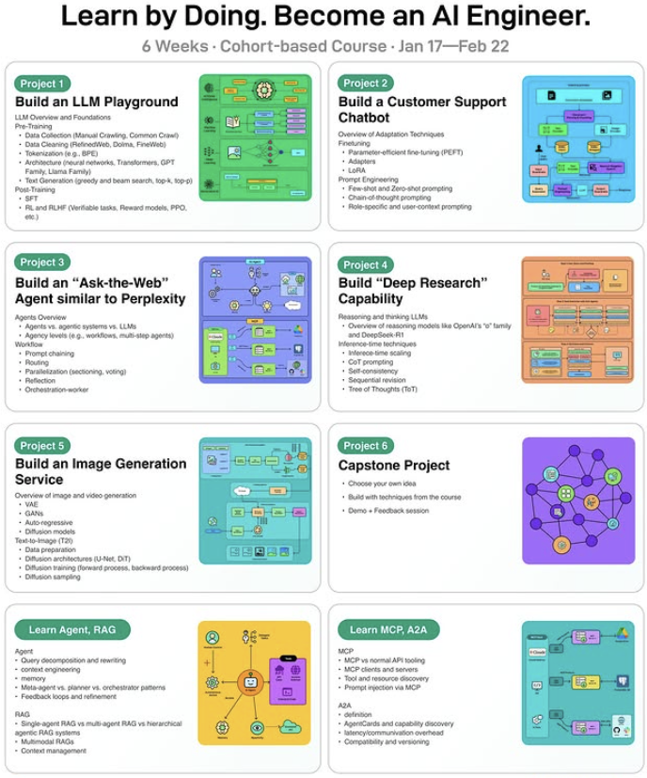
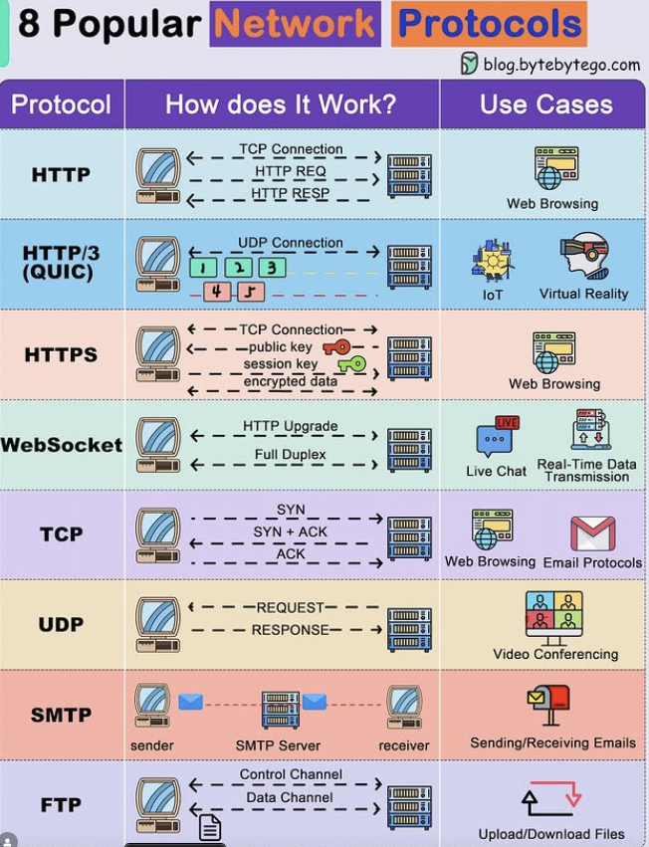

Slide 51
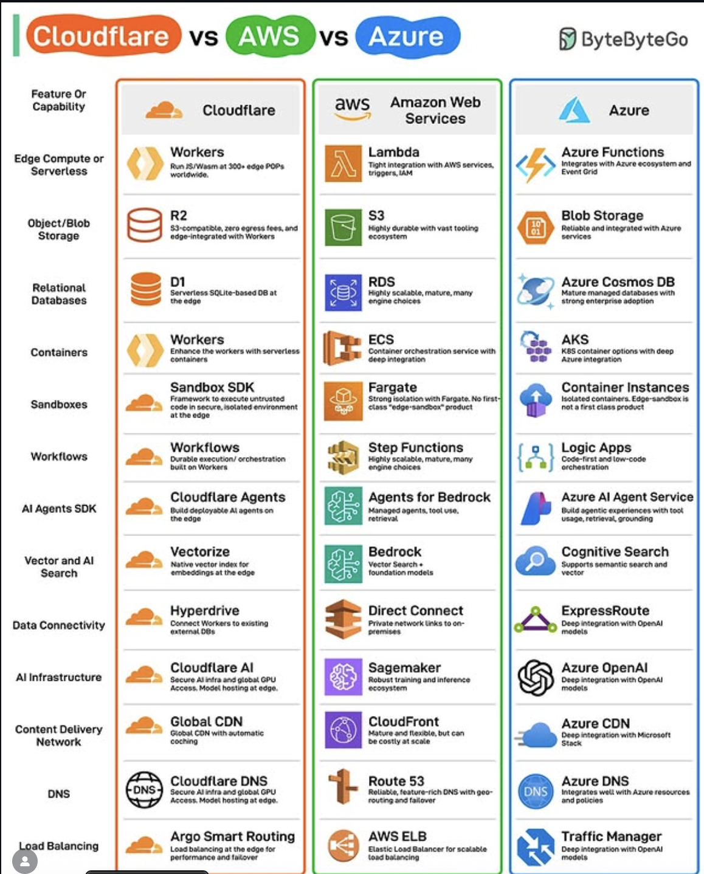
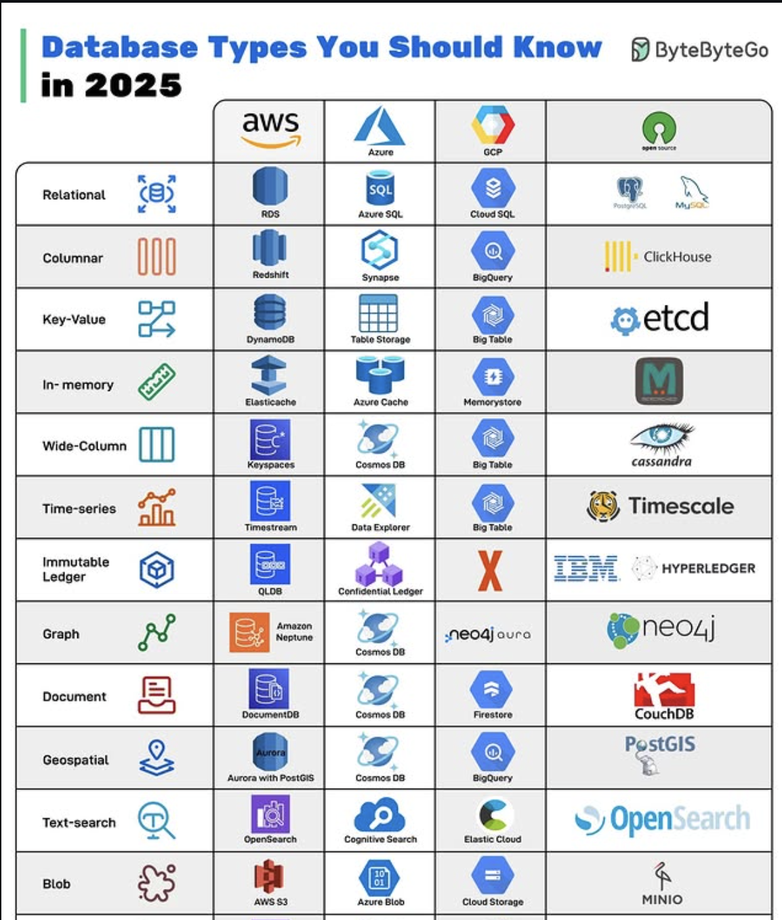

Slide 52
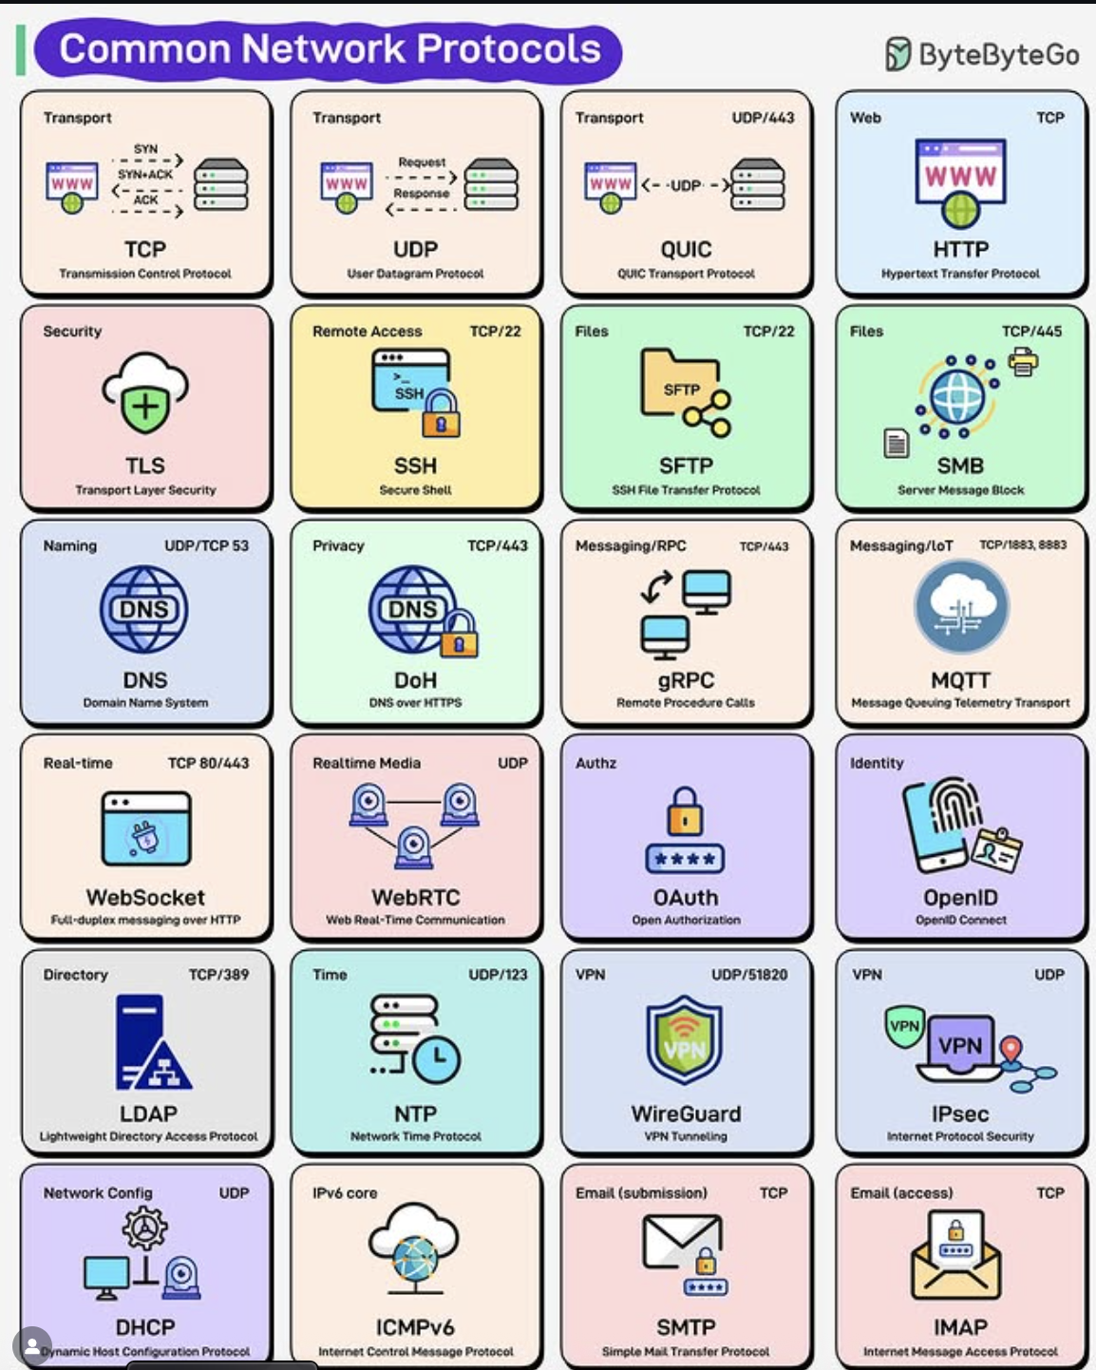
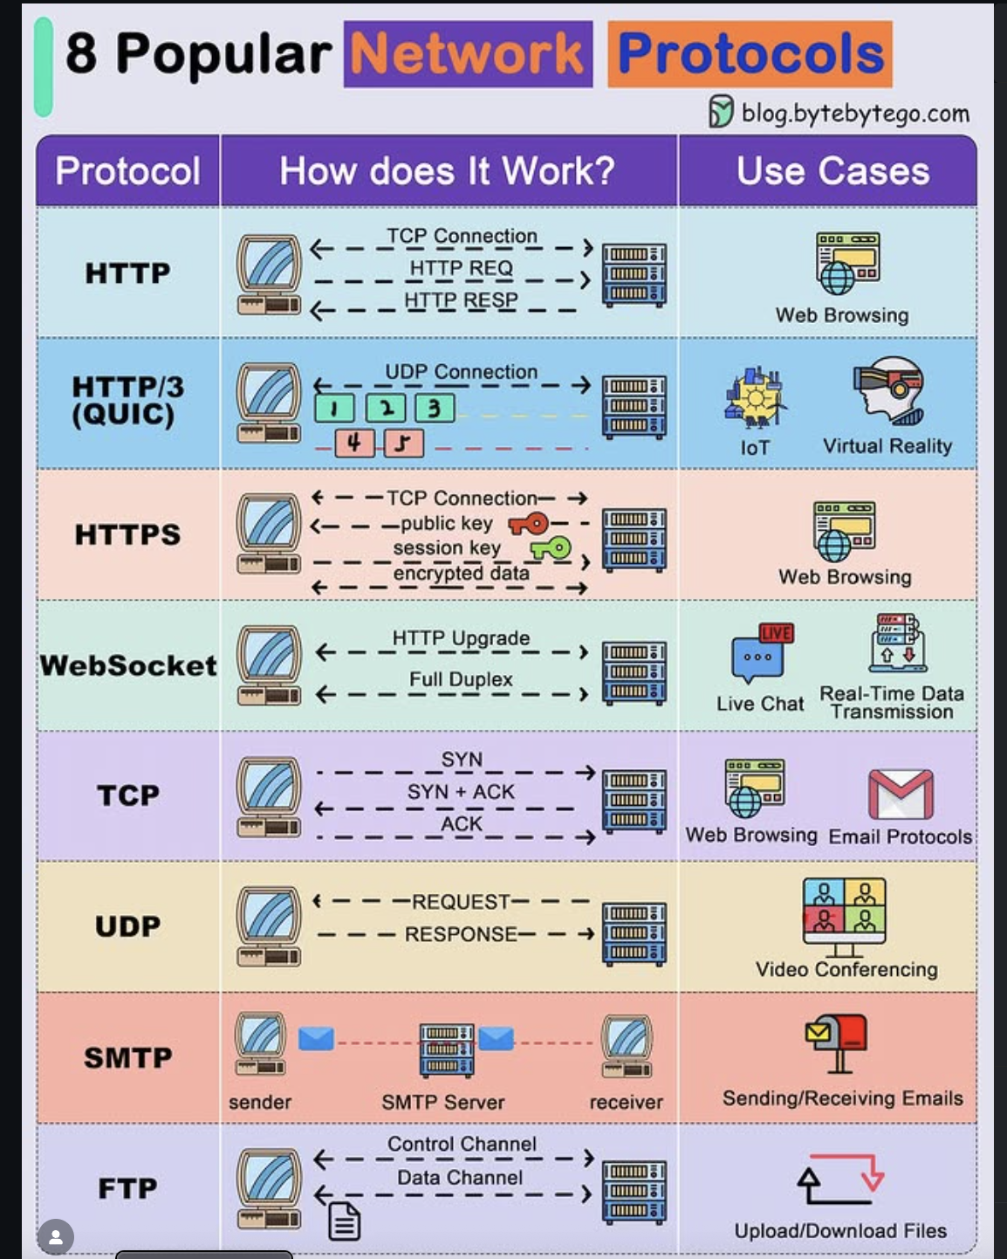

Slide 53
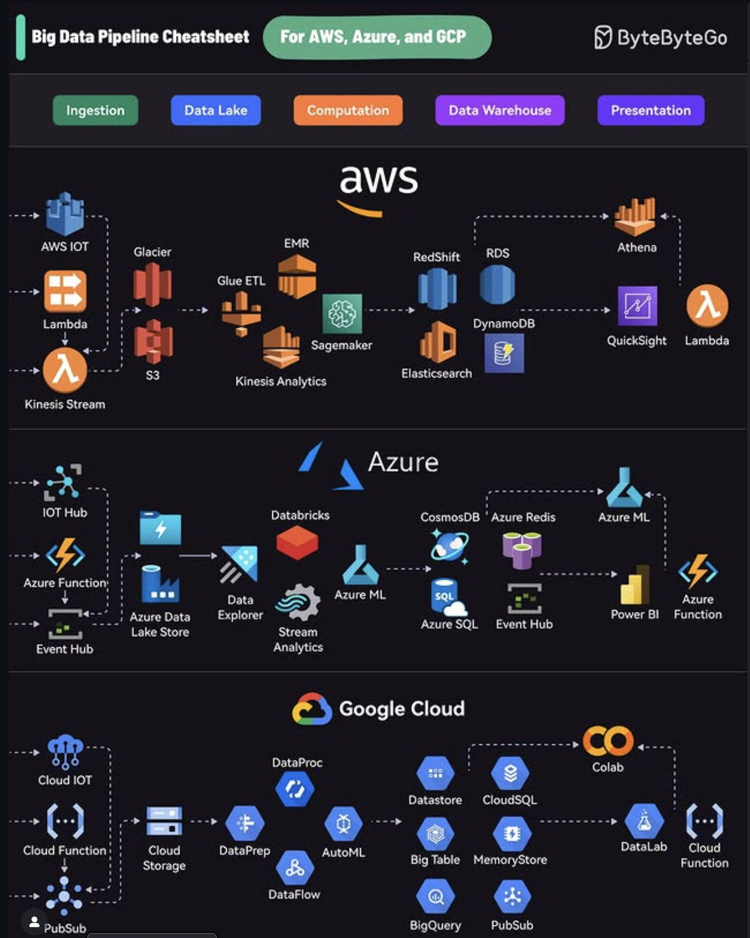
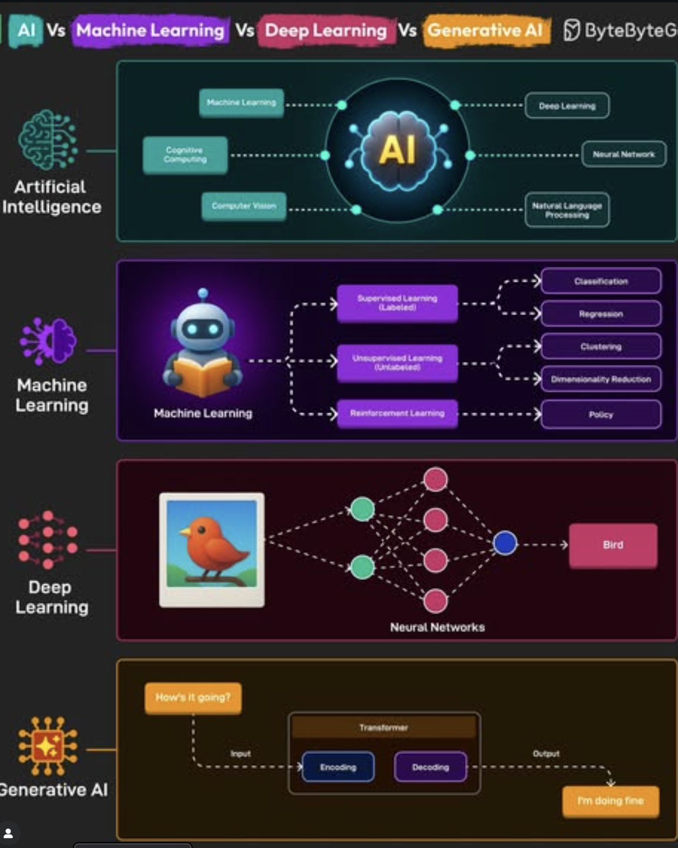

Slide 54
